Slide 1

Turf Management System: Revolutionizing Turf Booking & Team Management
Introducing our innovative turf management system designed to streamline turf booking, team formation, and turf management operations. This comprehensive platform offers a range of features for both turf users and owners, simplifying the entire experience.
NEXT GEN SOCCER

Slide 2
NEXT GEN SOCCER
Core Functionalities
1
Book Turf
2
Find Players
3
Create Teams
Effortlessly reserve turf slots based on availability, time, and location.
Connect with fellow players seeking teammates for matches or casual games.
Establish and manage your own team, inviting players and organizing matches.
4
Cancel Bookings
5
Weather Check
Flexible cancellation options allow for adjustments to your schedule.
Stay informed about weather conditions at the turf, making informed decisions about play.

Slide 3
USE CASES
1
Registration/Login
2
Upload Turf Information
3
Booking Turf
4
Cancel Bookings
5
Turf Removal
6
Weather Monitoring
7
Player Performance tracking
8
Match Performance history
9
Feedback Submission
10
Find Player

Slide 4
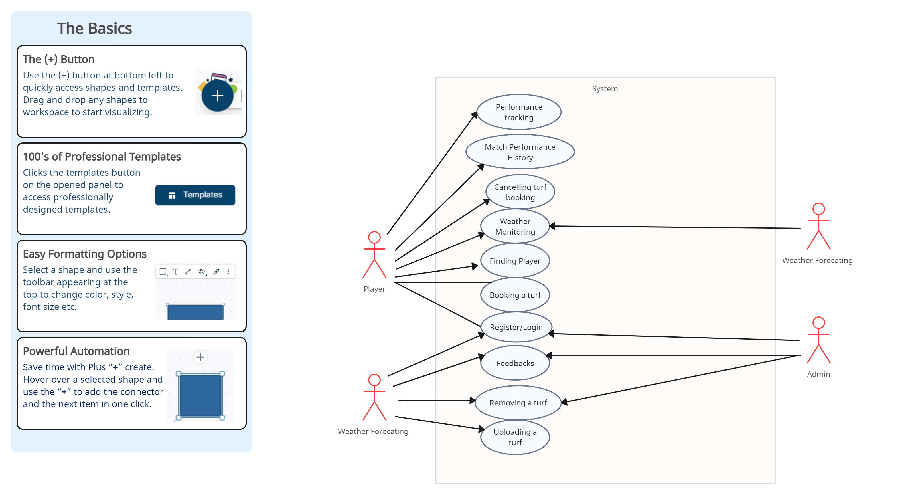
USE CASE DIAGRAM

Slide 5
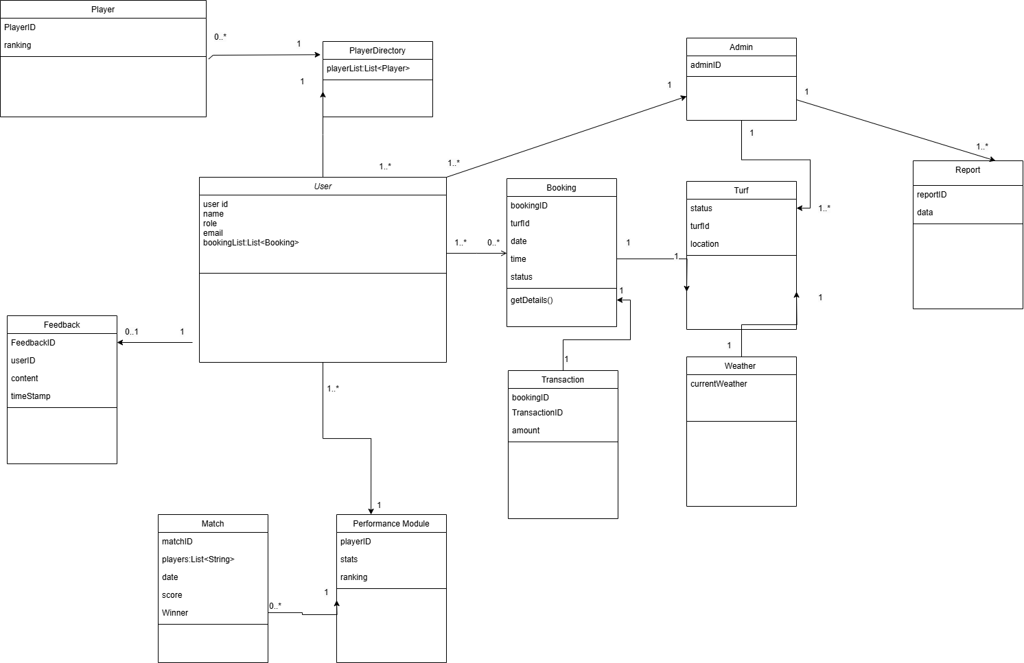
DOMAIN MODEL DIAGRAM

Slide 6
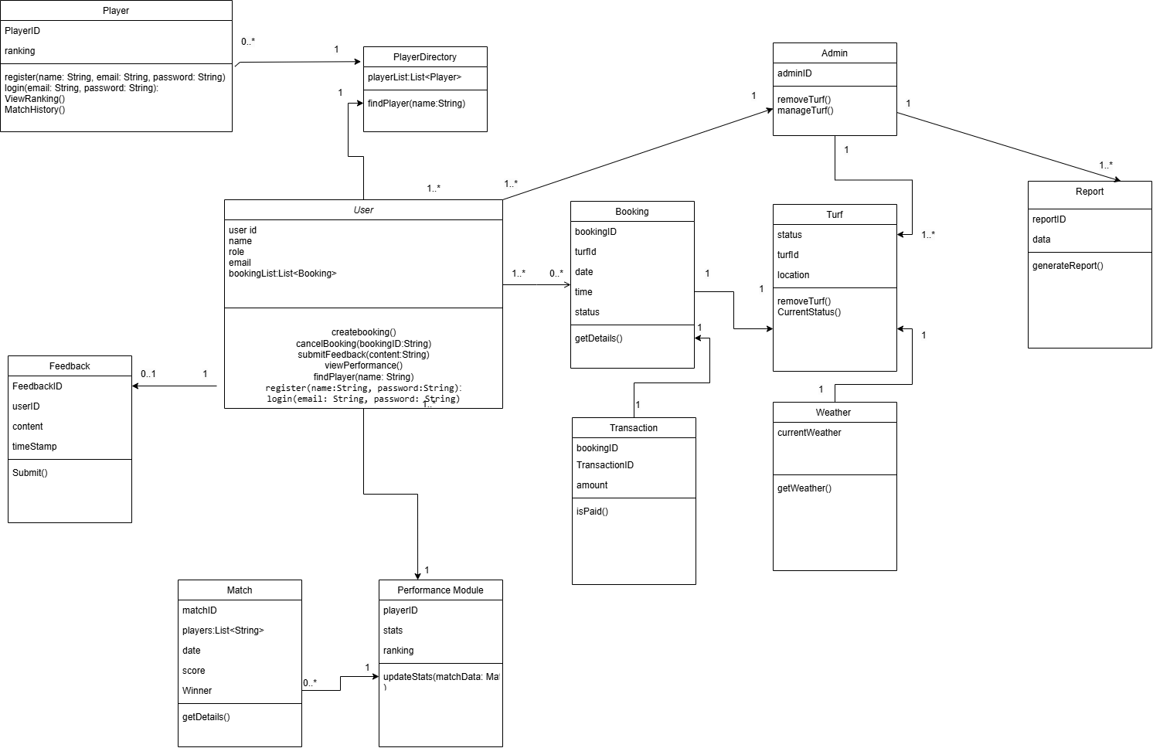
CLASS DIAGRAM

Slide 7
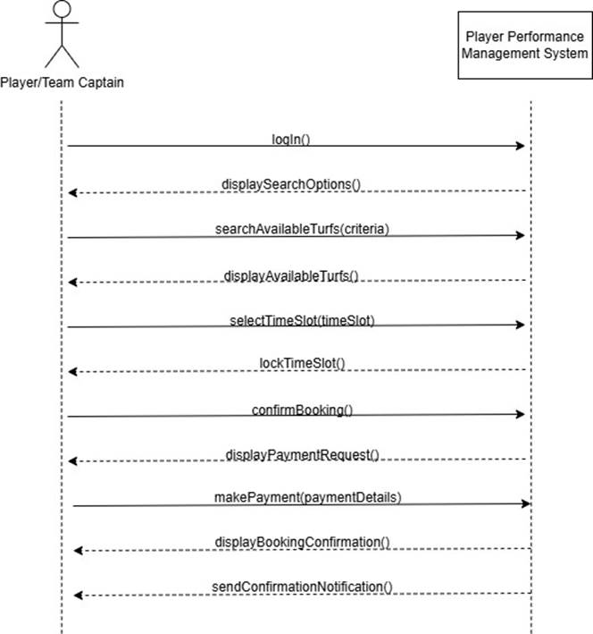
SYSTEM SEQUENCE DIAGRAM
BOOK TURF

Slide 8
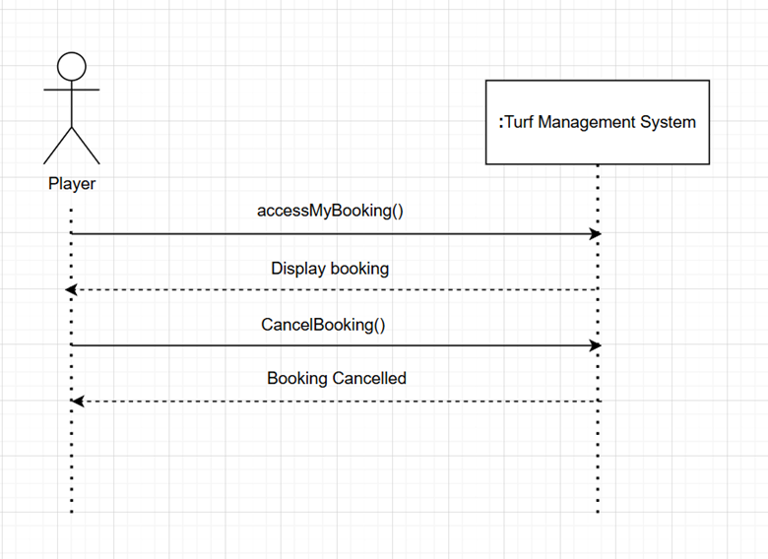
SYSTEM SEQUENCE DIAGRAM
CANCEL BOOKING

Slide 9
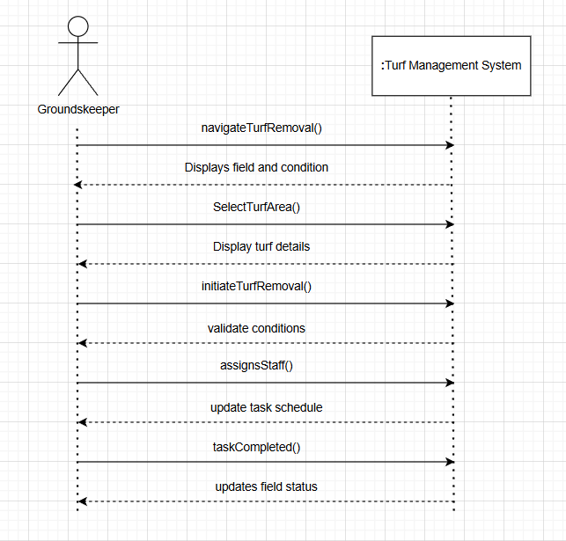
SYSTEM SEQUENCE DIAGRAM
TURF REMOVAL

Slide 10
SYSTEM SEQUENCE DIAGRAM
UPLOAD TURF INFORMATION

Slide 11
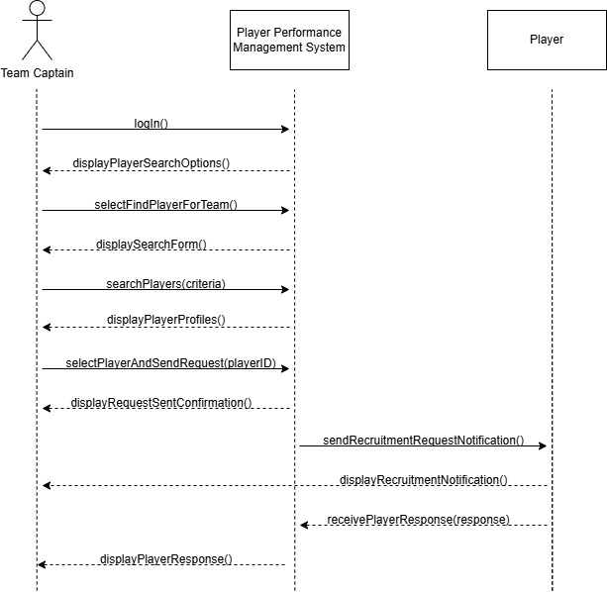
SYSTEM SEQUENCE DIAGRAM
FIND PLAYER

Slide 12
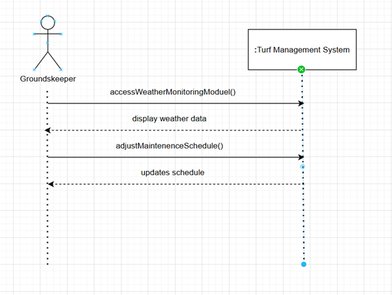
SYSTEM SEQUENCE DIAGRAM
WEATHER MONITORING

Slide 13
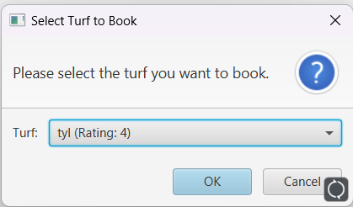
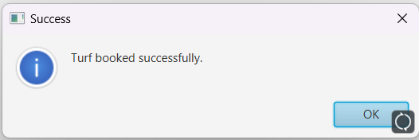
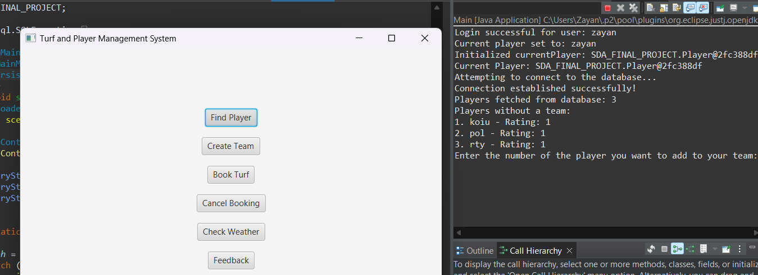
Book Turf
Find Players

Slide 14
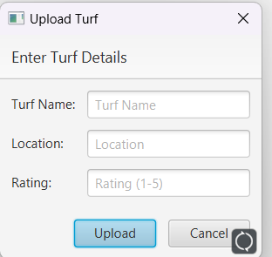
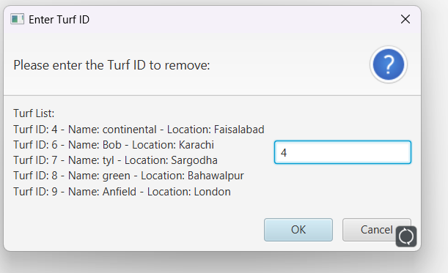
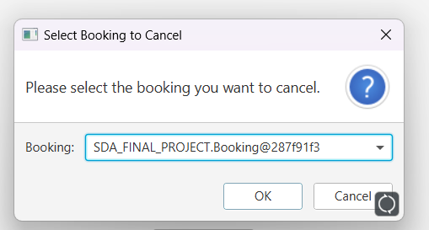
Turf Owner Features
Add Turf
Remove Turf
Manage Bookings
Turf owners can easily add their turf details to the platform, including location, pricing, and availability.
Owners have the flexibility to remove their turf from the platform if needed.
Review and manage incoming bookings for their turf, ensuring smooth operations.

Slide 15
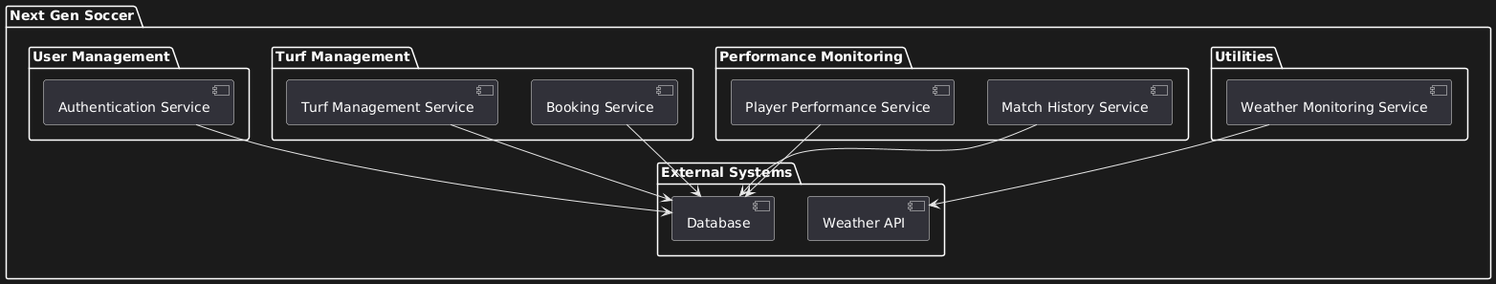
PACKAGE DIAGRAM

Slide 16
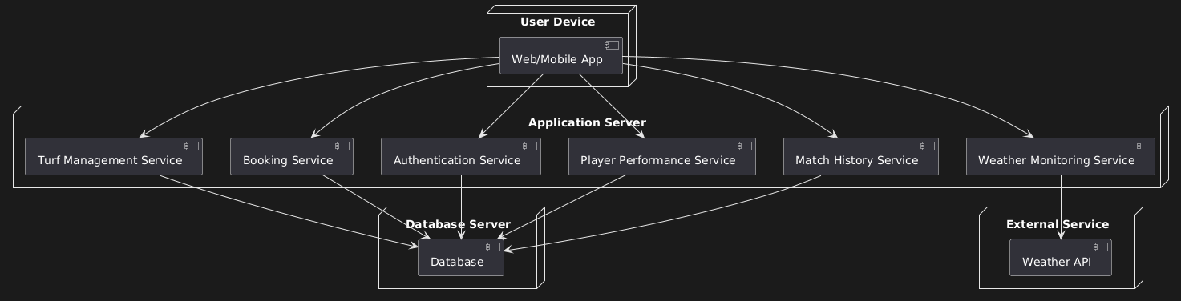
DEPLOYMENT DIAGRAM

Slide 17
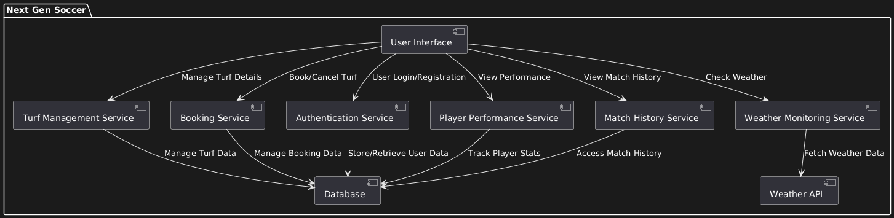
COMPONENT DIAGRAM

Slide 18

Contributions
Muhammad Zayan
22I-1010
Business logic layer
Linking front-end with back-end
Rohaan Khalid
22I-1034
Back-end development
Talha Khurram
22I-0790
Front-end development

Slide 19



Challenges Faced
User Interface Design
Creating a user-friendly interface that seamlessly integrates all functionalities.
Database Optimization
Ensuring efficient data management for smooth operation and scalability.
Weather API Integration
Implementing real-time weather data integration for accurate and reliable information.

Slide 20
Conclusion
Streamlined Turf Booking
Improved User Experience
Provides a user-friendly platform for booking turf slots, finding players, and managing teams.
Offers a comprehensive and intuitive experience for both turf users and owners, enhancing engagement.
1
2
3
Efficient Turf Management
Simplifies operations for turf owners, enabling them to manage bookings, add, and remove turf listings.

Slide 21
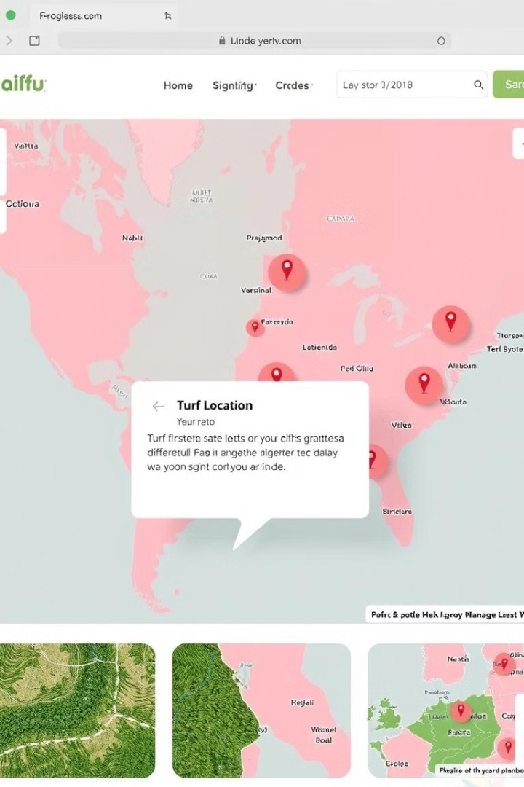



Future Plans
Turf Location Tracking
Implement real-time tracking of turf location and availability.
Integrated Payment System
Offer seamless online payment options for booking turf slots.
Social Integration
Enable social media integration for sharing team information and matches.

